Slide 1




Investigation on the Mental State of College Students
Reporter：王奕澄，郑章庆，丁嘉晖，郭琪，王宇涵

Slide 2




04
Discussion
Made by 王宇涵

Slide 3

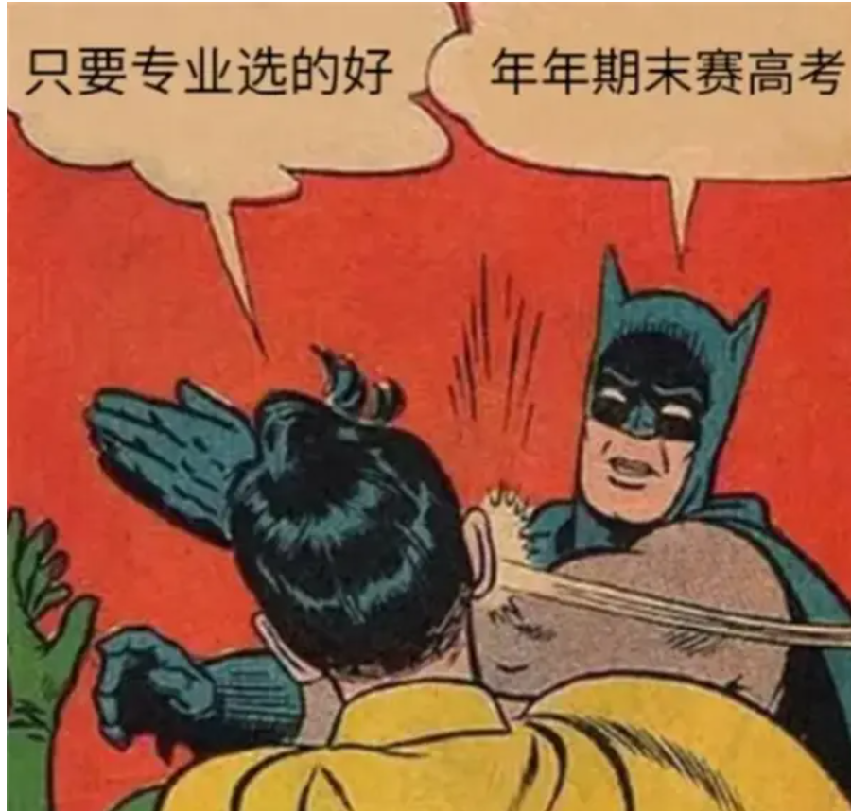
Conclusion & Significance
our data survey and analysis reveal that the vast majority of college students' mental states have not reached their ideal expectations.
Most college students take pleasure in making fun of themselves.

Slide 4


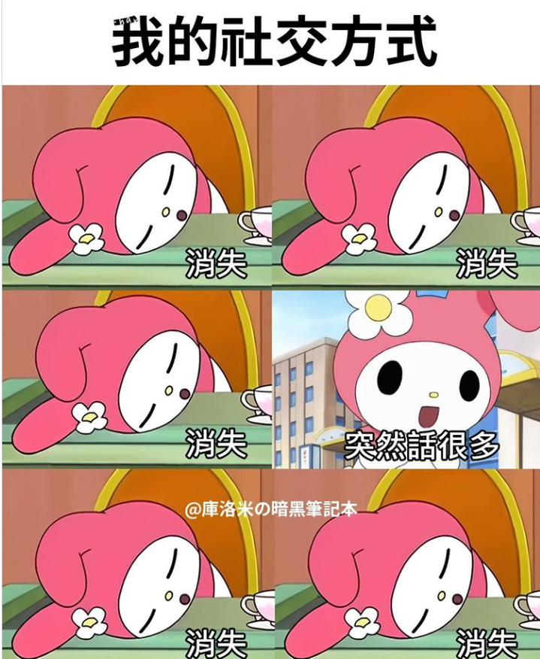

Recommendations
01 | 02 | 03 | 04
Study | Diet | Social | Sleep

Slide 5
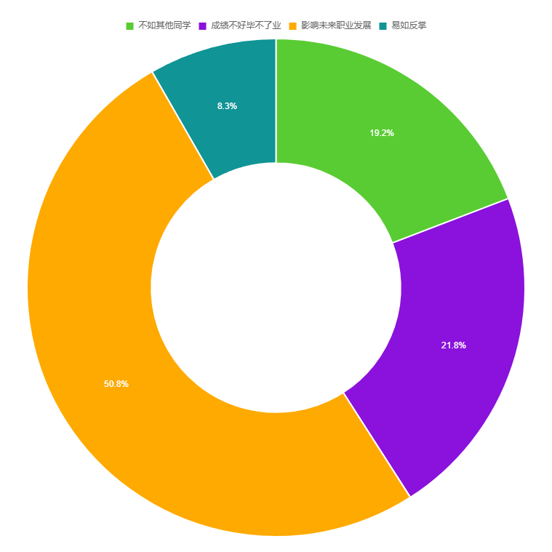

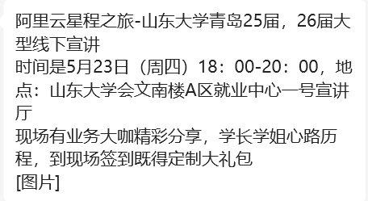
Study
Seek career counseling services offered by our university. These services can provide guidance on career paths, help us understand the job market, and offer resources for career planning.

Slide 6
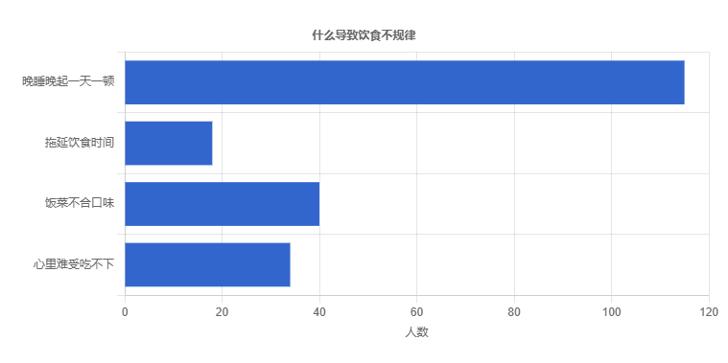
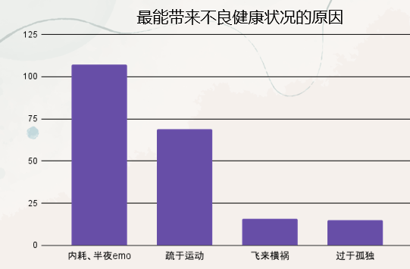

Diet & Sleep
From the diet, we can see that irregular sleep is an important cause of irregular eating habits
while internal conflicts and lack of sport are the root causes of irregular sleep.

Slide 7
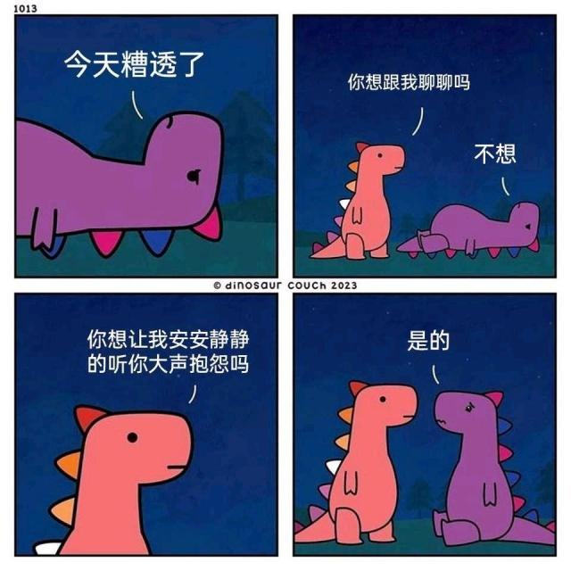
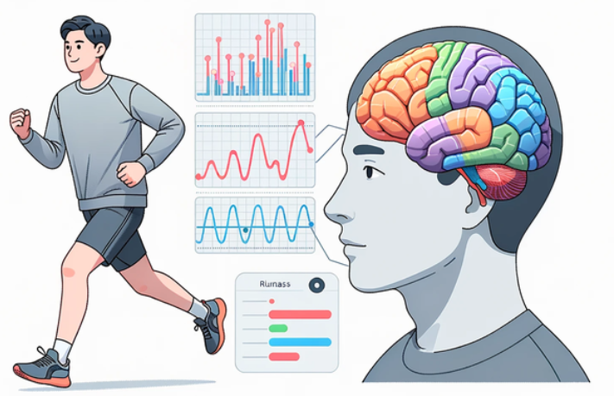

Inner Conflicts?
Connect with Others:
Talking to friends, family, or a counselor can provide emotional support and perspective.
Exercise Regularly: Physical activity is an effective way to alleviate stress and improve mood
Get Enough Sleep: Adequate rest is crucial for managing stress and maintaining overall well-being.

Slide 8
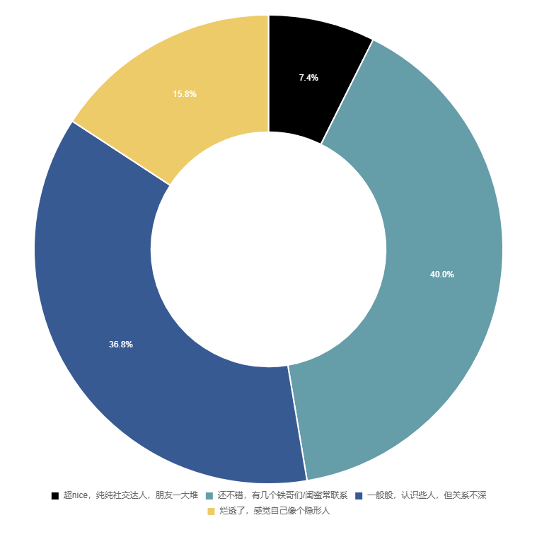

Social Network
Lauret Miller
Only less than half of the people believe they have relatively normal social relationships
“We are born alone, we die alone, and in between, we live through love and friendship”

Slide 9


Social Network
Accept Others: Interact with others with sincerity and friendliness, and learn to respect others.
Accept Yourself: Embrace your uniqueness, strive to improve your weaknesses, enhance your strengths, and avoid comparing yourself to others.

Slide 10
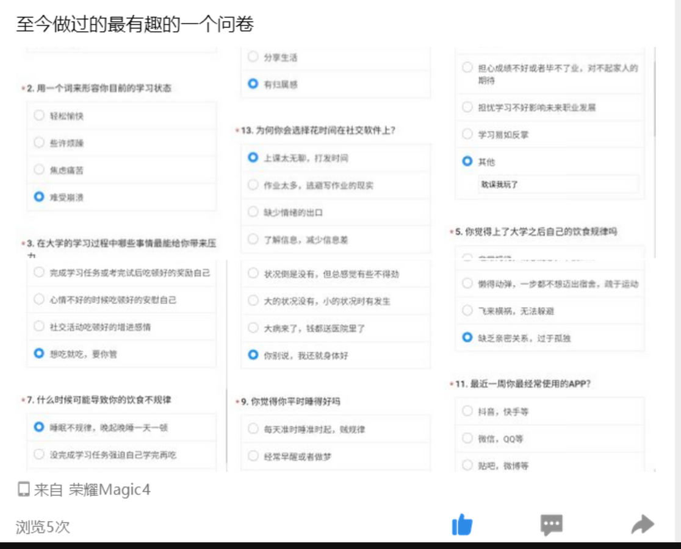

Acknowledgement
Thank you to everyone who enthusiastically filled out the forms and provided us with positive feedback, to my diligent and dedicated teammates and to our great teacher Mr.Wang

Slide 11
Thanks!
Reporter：王奕澄，郑章庆，丁嘉晖，郭琪，王宇涵

